Slide 1
Welcome!

Slide 2
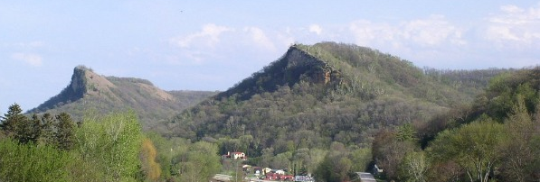
You’re here!
Winona, MN:
Current population 27,000 +
Part of the “Driftless Region”
Winona’s weather station records warmest avg temps of any in MN!
Winona State University
Founded 1858, as “Normal School” (school for elementary teachers)
First university founded west of the Mississippi
Current student population: 8,002

Slide 3
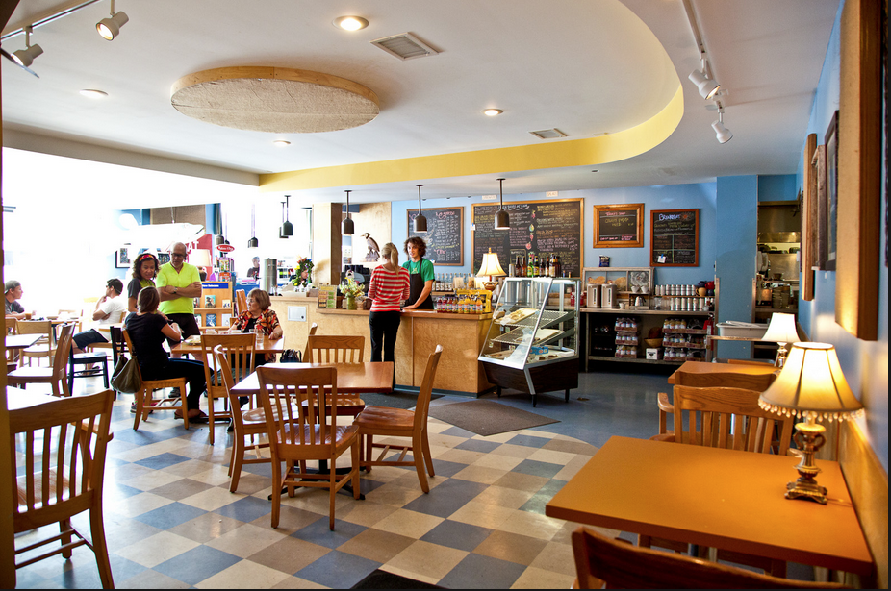
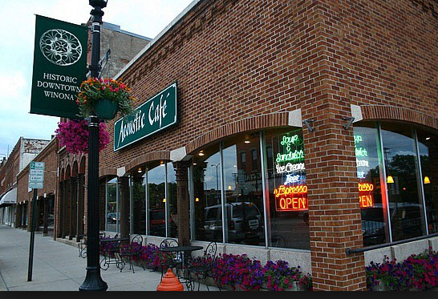
Coffee shops
Blue Heron
Blooming Grounds
Acoustic Café
Mugby Junction

Slide 4
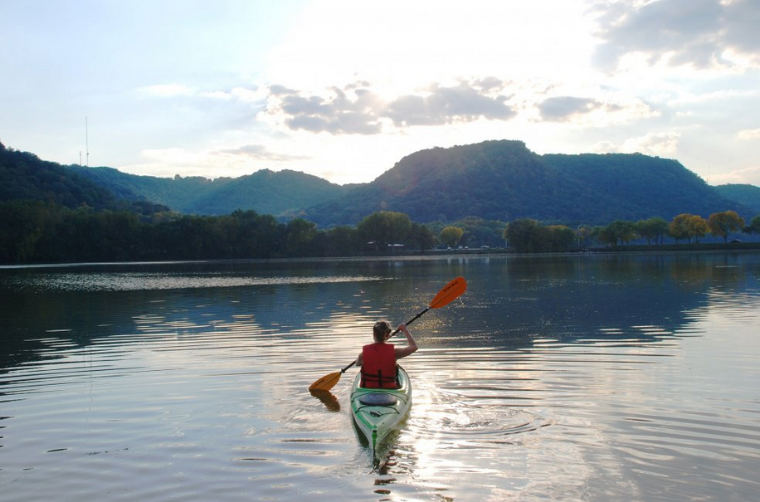
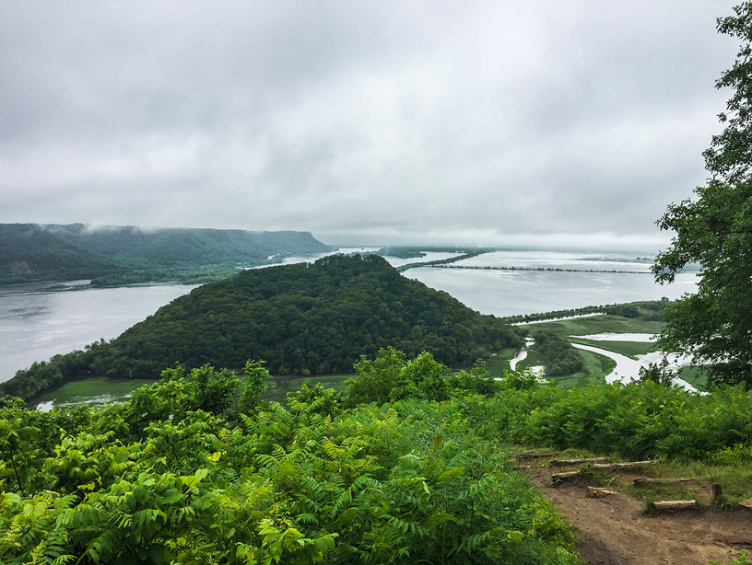
Outdoors
Winona Lakes
3.4 miles around large East lake
1.8 miles around small West lake
Lake Lodge (part of Parks and Rec system)
$15 one-time membership gets you:
Canoes
Bikes
Lawn games
State Parks within 30 min drive (or longer bike ride!)
MN:
Latsch
Whitewater
Great River Bluffs
WI:
Merrick
Perrot
Trempeleau Wildlife Refuge
Brady’s Bluff, Perrot State Park

Slide 5
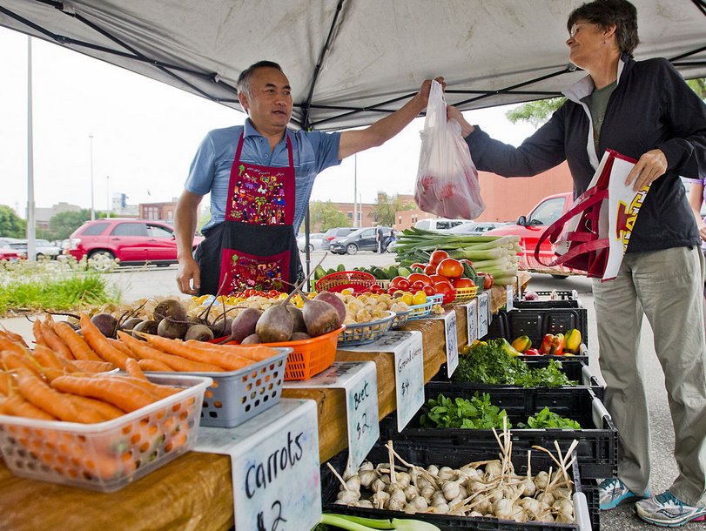
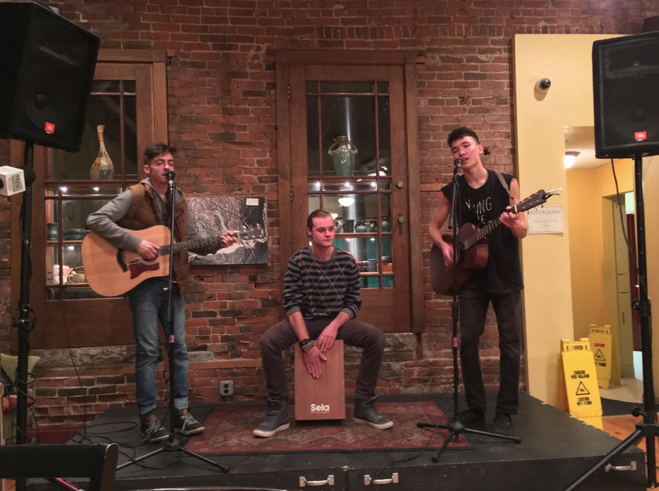
Other
Farmer’s Market each Saturday, 7:30-12; Midtown Foods Parking Lot
Free Friday “Concerts on the Green”
Part of Great River Shakespeare Festival
Start June 23, just outside Gildemeister
Live music at Acoustic Café
Most Fridays and Saturdays
Free!

Slide 6
WSU Statistics & Data Science
- 7 dedicated statistics faculty (some of which dabble in data science)
- Statistics BS:
Offered since ____
Calculus I-III, linear algebra
Two semesters of intro stat
Regression analysis
Experimental design and analysis
Mathematical statistics (stat theory)
Consulting
8-15 students graduate each year
- Data Science BS:
Began Spring 2015
Expansive growth
CS core
“Interdisciplinary emphasis”
Intro to Data Science
Management of structured data
Data visualization
Advanced “data computing” with Python
Unsupervised and supervised learning

Slide 7
Your day to day at the REU…
First half (~June): “Filling the toolkit”
Meet 8:30-12 in Gildemeister 135
Lunch 12-1:30
“Homework” from the day’s concepts: 1:30-4:30
Faculty will be available to answer emails once in the afternoon
Present results next morning
Lots of trips planned as well
Tentative Calendar
Second half (~July): Work on IPUMS research questions
JSM: July 29-August 3
Concepts covered as needed
You are welcome to use Gild 135 or lounge next door (code 7913*) anytime
Play time throughout!

Slide 8
Let’s get to know each other!
What first piqued your interest in statistics/data science?
What are some of your “hobbies”?
What aspects of the REU most excite you?

